Slide 1
Networking Unit 5

Slide 2
Agenda
Stage 01
Stage 02
Stage 03
Stage 04
Learning Present Continuous in Active and Passive Voice
Learning about networking and describing options
Reading for specific information
Listening for specific information

Slide 3
Revision of learned terms
01
02
50%
50%
Can you make up sentences?
Team 1
Team 2

Slide 4
Conduct a survey “Find someone who…”. Fill in the table with your groupmates’ answers by asking them to answer the following questions
Name | Who traveled a lot | Who speaks multiple languages | Who has a unique or uncommon skill | Who is passionate about a hobby

Slide 5
Let’s discuss these questions
What are some components of a computer network?
01
02
How does a computer network help a business?

Slide 6
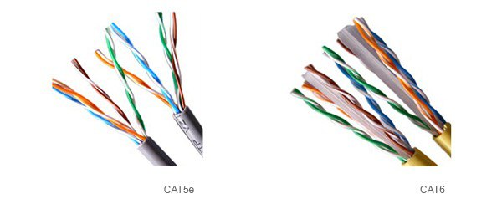
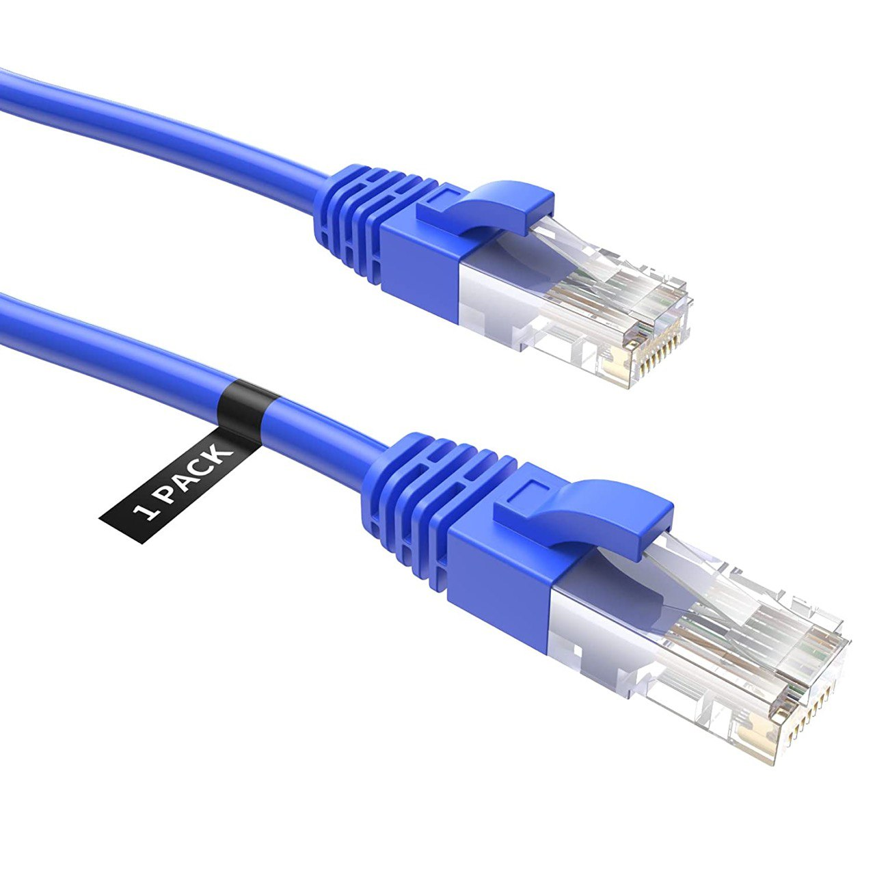
CAT-5 cable
Category 5 cable is a twisted pair cable for computer networks.

Slide 7
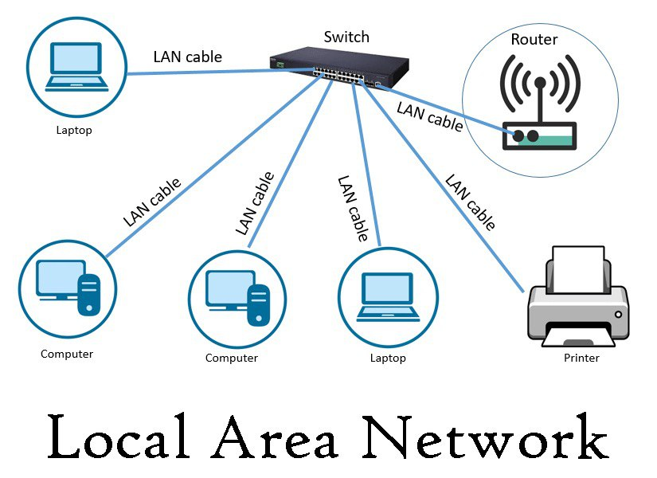
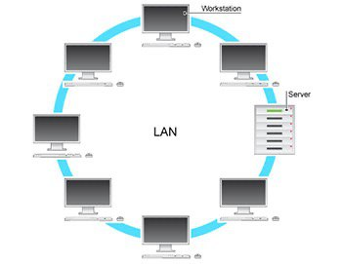
LAN
A local area network (LAN) is a collection of devices connected together in one physical location, such as a building, office, or home.

Slide 8
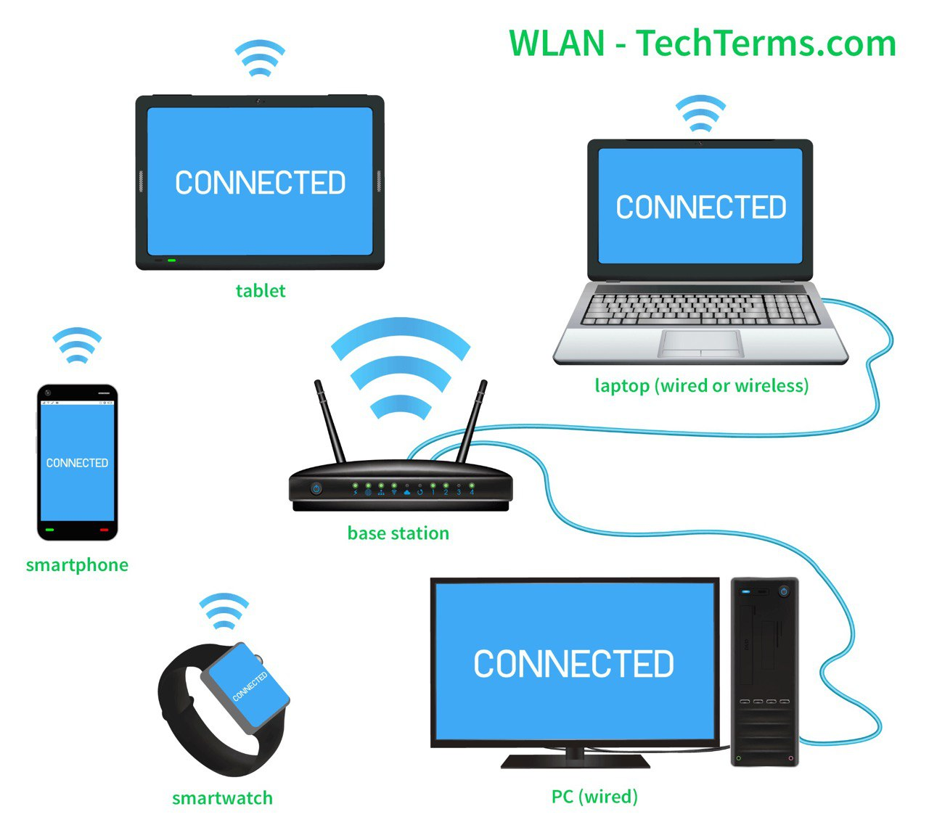
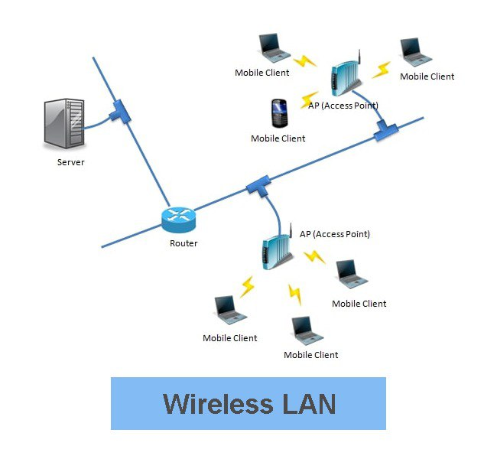
Wlan
A wireless LAN (WLAN) is a wireless computer network that links two or more devices using wireless communication to form a local area network
(LAN)

Slide 9
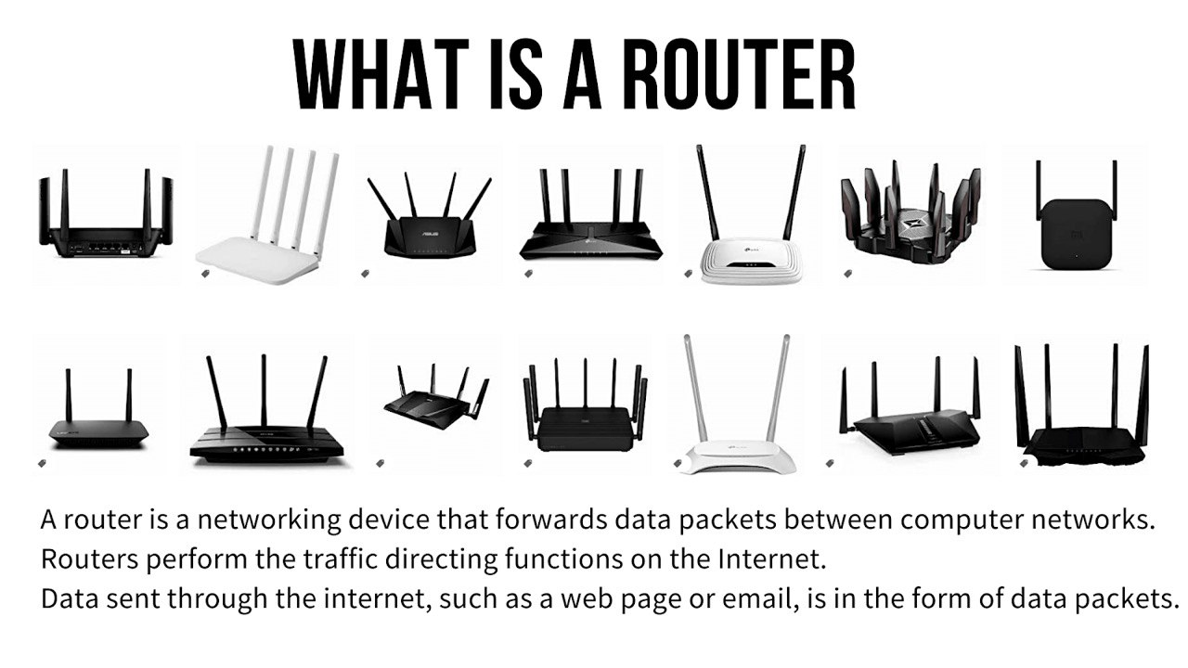
Router

Slide 10
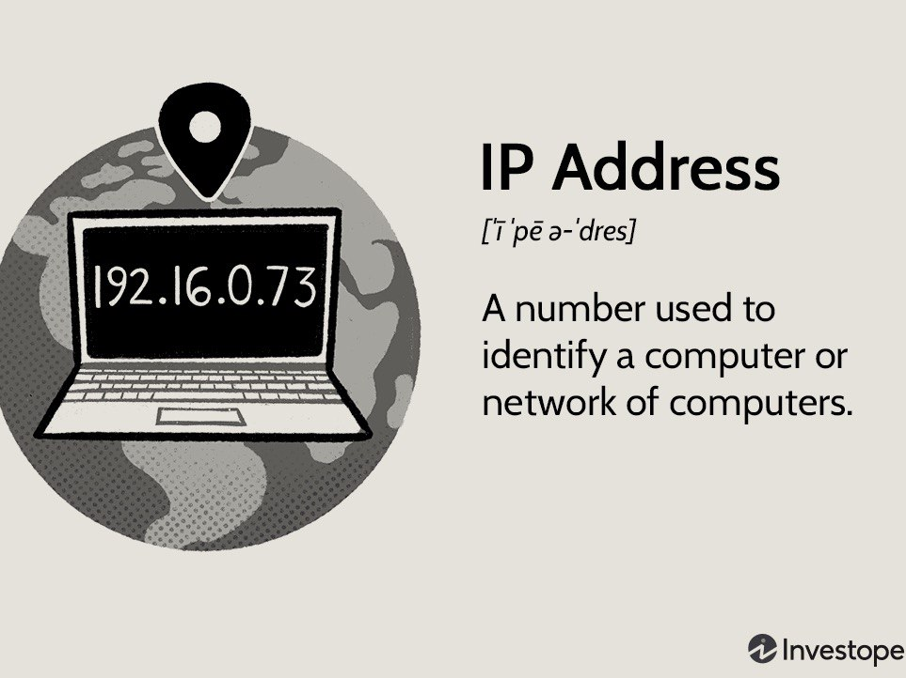
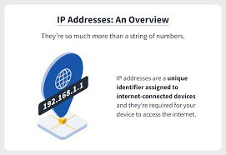
IP address

Slide 11
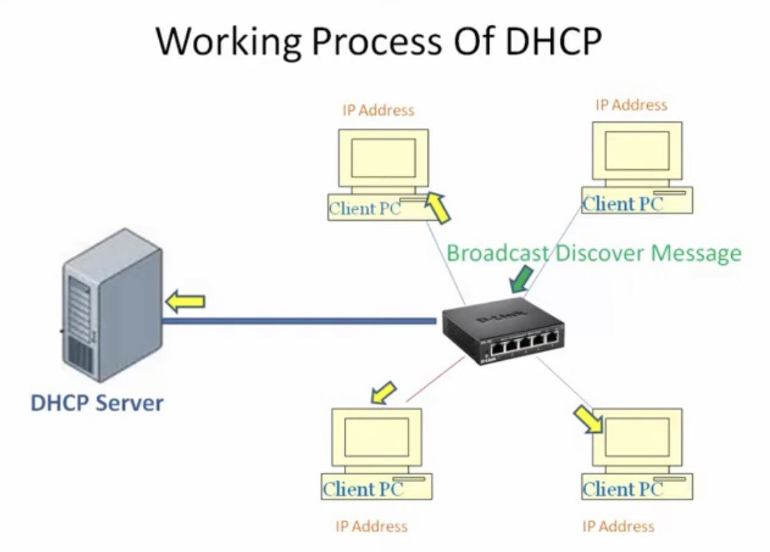
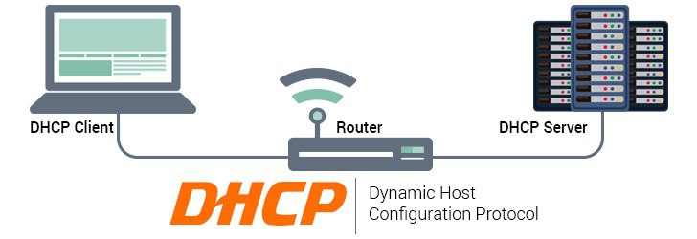
DHCP
A Dynamic Host Configuration Protocol (DHCP) is a network server that automatically provides and assigns IP addresses and other network parameters to client devices.

Slide 12
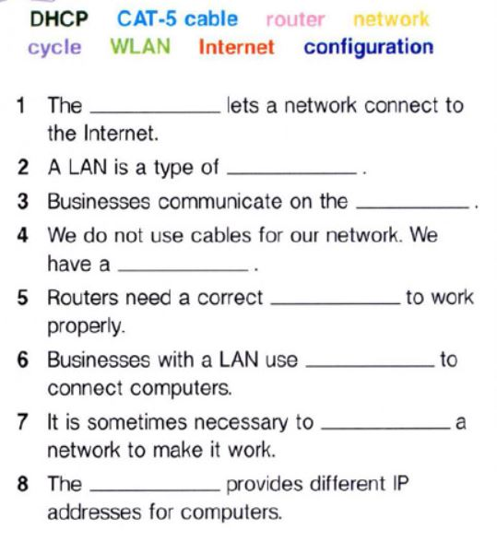
Fill in the blanks with the correct words or phrases from the word bank.
router
PROPOSAL B
network
Mercury
03
Internet
It’s the closest planet to the Sun
WLAN
configuration
Jupiter
04
CAT-5 cable
It’s the biggest planet of them all
cycle
PROPOSAL A
DHCP

Slide 13
Choose the best definition for each word
1. router
A. a part of a computer
B. a wireless network
C. a networking device
2. IP address
A. a city-wide network
B. an identification number
C. a networking device
3. LAN
A. a local network
B. a networking device
C. a wireless network

Slide 14
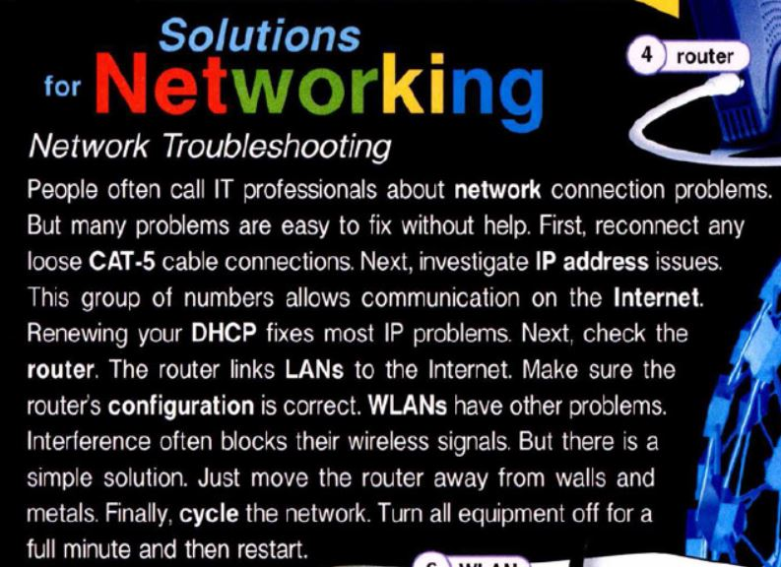
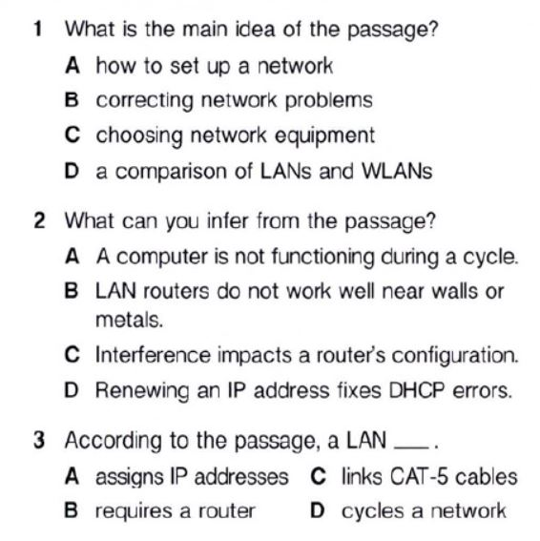

Slide 15
Linko Connect
Linko Connect provides a wide variety of products and services. Are you in need of a network? Linko Connect has many different networking packages.
Get our lowest available price with the bronze package. Link multiple home or office computers together with a LAN. We use enhanced CAT-5 cables to connect your machines.
Don’t like wires and cables? Don’t worry! With our silver package, you’ll get a WLAN. Our wireless networks transmit signals through a central router. Each router’s antenna can transmit a signal from blocks away.
Finally, our gold package includes our best high-speed broadband. You’ll surf the Internet at 50 Mbps!
All packages come with separate or built-in modems.

Slide 16
Read the webpage. Then, mark the following statements as True (T) or False (F).
__ The bronze package includes a wireless network.
__ The silver package connects computers through a router.
__ The gold package is the least expensive option.
F
T
F

Slide 17
Grammar Focus: Present Continuous in Active and Passive Voice
The present continuous tense is used to talk about actions that are happening now or around the current time. In the active voice, the subject performs the action. For example, "I am eating lunch" - "I" is the subject and is performing the action of eating.
S + am/is/are + V +ing
In the passive voice, the subject receives the action. The passive voice is formed by using a form of "to be" (am, is, are) followed by the past participle of the main verb. For example, "The lunch is being eaten by me" - "The lunch" is the subject and is receiving the action of being eaten.
S + am/is/are +being + V+ing

Slide 18
Examples:
In the active voice:
Active: "The programmer is writing the code.“
Explanation: This sentence describes the programmer’s action in writing the code.
In the passive voice:
Passive: "The code is being written by the programmer."
Explanation: In this sentence, the code is receiving the action of being written by the programmer.

Slide 19
Write these sentences in passive voice The IT team is updating the software. The programmer is writing code for the new feature. The software developer is testing the application for bugs. The programmer is debugging the software. The team is developing a new mobile application.

Slide 20

Make up the sentences in the Present Continuous in passive voice and give your work to your peer to rewrite those sentences in active voice.

Slide 21

Listen to an IT professional talking with a customer about setting up a network.

Slide 22

Listen to the customer calling the help line about the operating system. Choose the correct answers.
1. What does the woman want to buy?
A. a LAN
B. a WLAN
C. a router
D. a CAT-5 cable
2. Why does the woman choose a wireless network?
A. She does not have CAT-5 cables.
B. Her computers are not close to each other.
C. She does not like her present network.
D. Her router doesn't support a LAN.

Slide 23
Listen again and complete the conversation
IT Professional: Hi. Can I help you find something?
Customer: Oh, please. I need a 1) ___________.
IT Professional: Well, there are a few types. What kind of 2) ________ do you have?
Customer: I don't have one yet, but it's for the computers in my home.
IT Professional: Do you want a LAN or a WLAN? Some routers don't 3) _______ both types.
Customer: What's the difference?
IT Professional: A WLAN 4) _________ wirelessly. A LAN connects computers with CAT-5 cables.
Customer: My computers are far 5) __________. I'd need a WLAN.
1. router 2. network 3. support 4. connects computers 5. apart

Slide 24
Watch a video and complete the blanks
Special Agent Nickolaos Contaxakis gives his advice on what ________1) you should buy with your next computer purchase. The ones that should be ________2) a necessity he calls necessaries. For example, ________3) is necessary if someone wants to print. Certain ______4) like those that attach the printer to the computer are also necessary. The keyboard and _________5) are also considered very vital components. Mice also come in different sizes for different purposes. The ones ___________6) for gaming, for example, are larger and faster.
used, accessories, mouse,
cables,
paper, considered

Slide 25
Offering a solution 1. You can never find your saved documents 2. You want to move files into a folder, but you don’t know how 3. You want to look at a certain window, but still have the others easily available 4. You want to make a window fill the entire screen. 5. You want to create a shortcut, but don’t know how

Slide 26
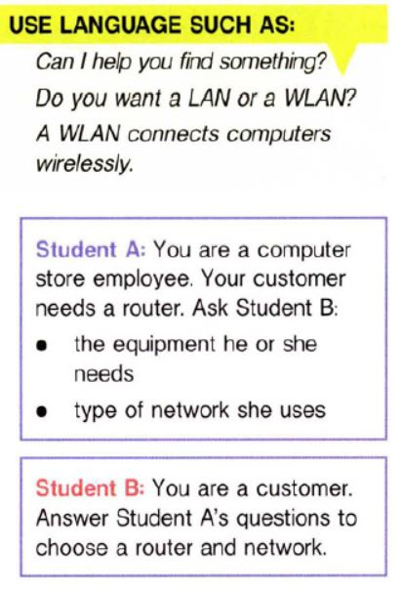
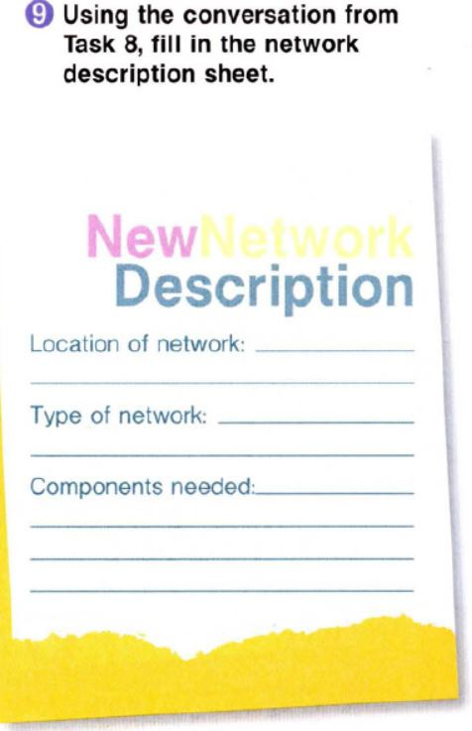

Slide 27
Home assignment
Answer the questions in written form:
1.If you feel there is a lack of security for data, which is because of?
2.If you think that the network is not performing well, what is the reason for the poor performance of the network according to your view?
3.What suggestions will you give to improve the performance of the network, if you are one of the network design engineers?

Slide 28


Do you have any questions? IF NOT, then

Slide 29
The User Interface
Unit 6

Slide 30
Agenda
1. analyze a problem with the user interface;
2. read for specific information;
3. experiment with different design ideas.

Slide 31
Food for thought
1. What is a User Interface? 2. How does a User Interface make computing easy?

Slide 32
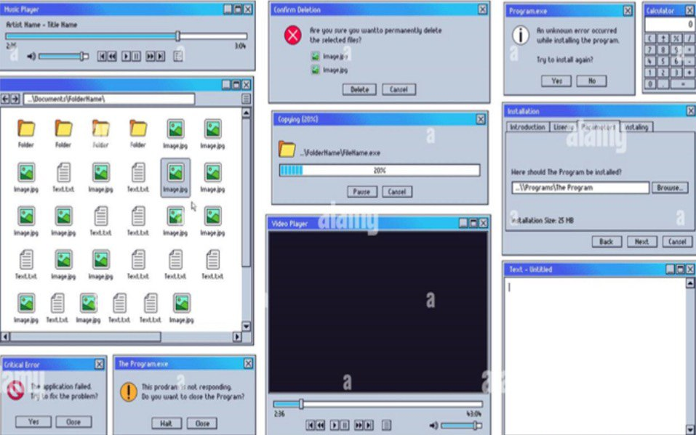
Analyze a problem of this User Interface (UI) What is wrong with this user interface?
Old user interface. Old computer music and video player UI, text editor, and critical system error alert notification window vector illustration set.

Slide 33
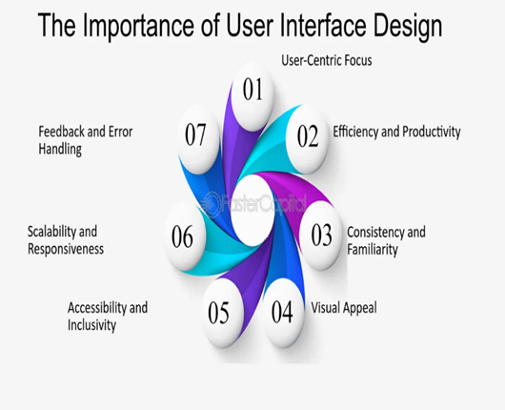
Designing the User Interface Follow eight basic guidelines:
Design a transparent interface;
2. Create an interface that is easy to learn and use;
3. Enhance user productivity;
4. Make it easy for users to obtain help or correct errors;
5. Minimize input data problems;
6. Provide feedback to users;
7. Create an attractive layout and design;
8. Use familiar terms and images.

Slide 34
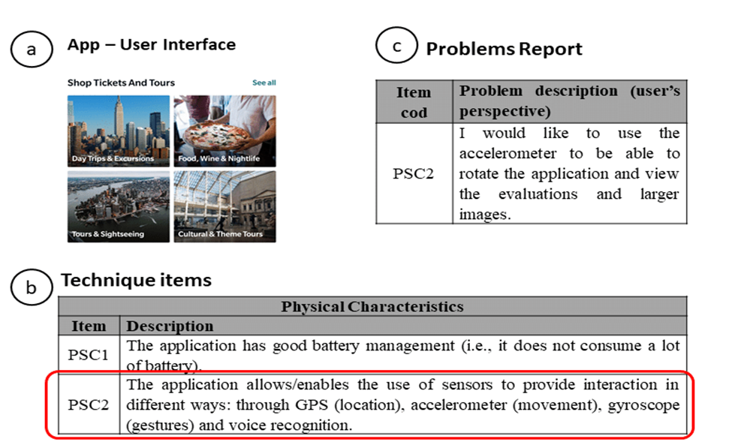

Slide 35
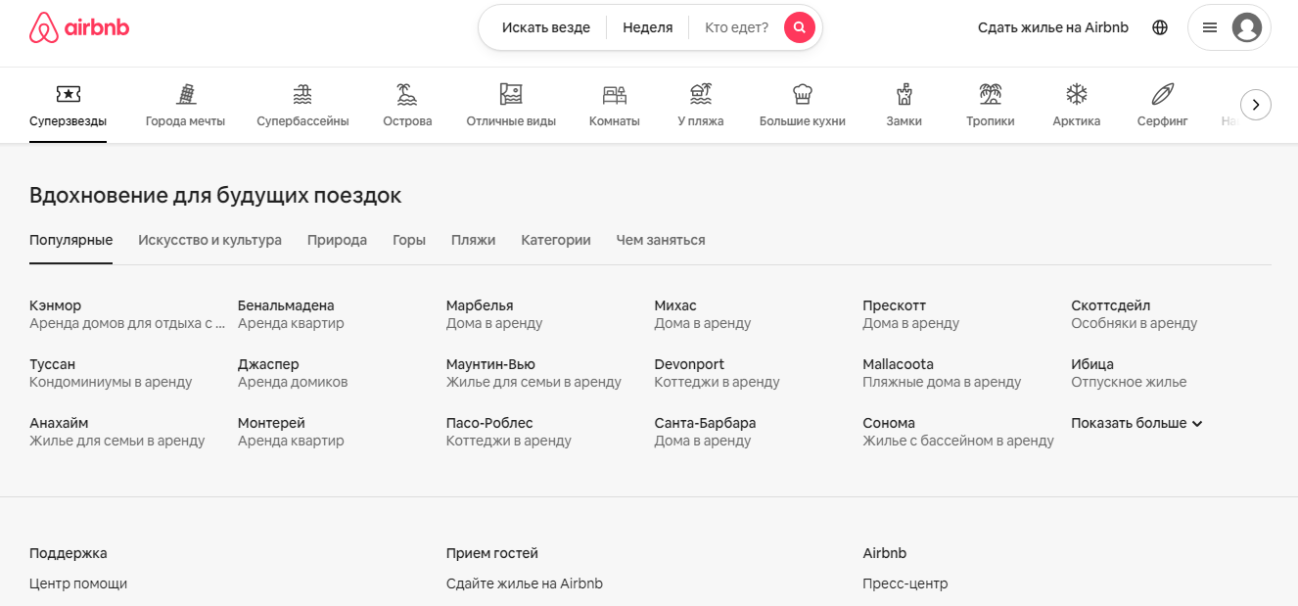
Let’s look through some successful and unsuccessful interface design cases

Slide 36
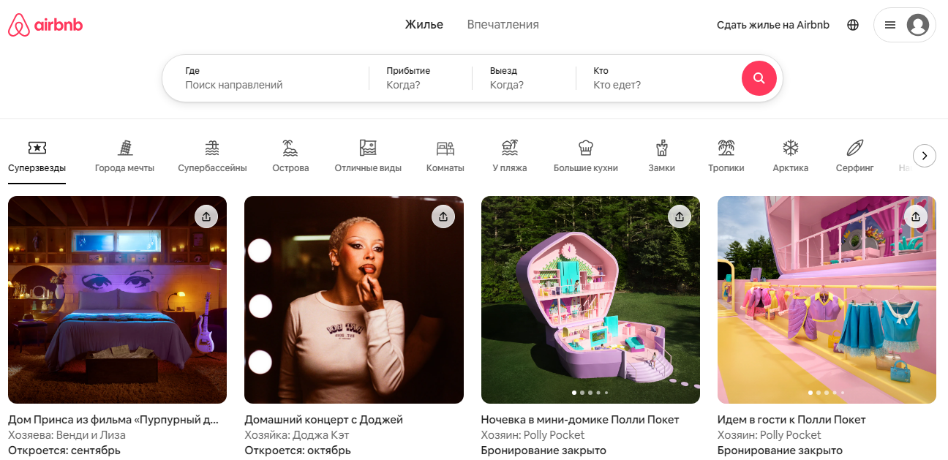

Slide 37

Healthcare.gov Interface Design Case

Slide 38
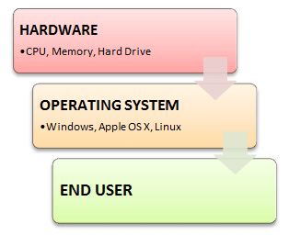
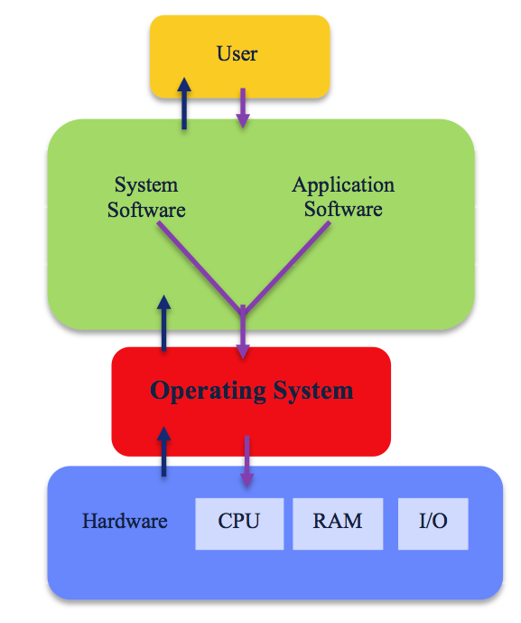
OS – operating system
An operating system (OS) is a set of programs that manage computer hardware resources and provide common services for application software.

Slide 39
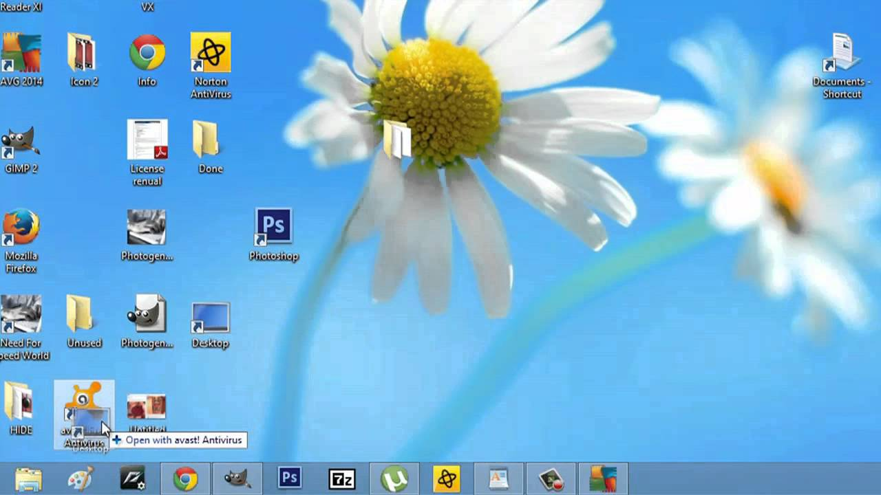
icons
Icon is a pictogram (symbol) displayed on a computer screen . On our monitor icons represent office equipment, software programs, and social media networks.

Slide 40
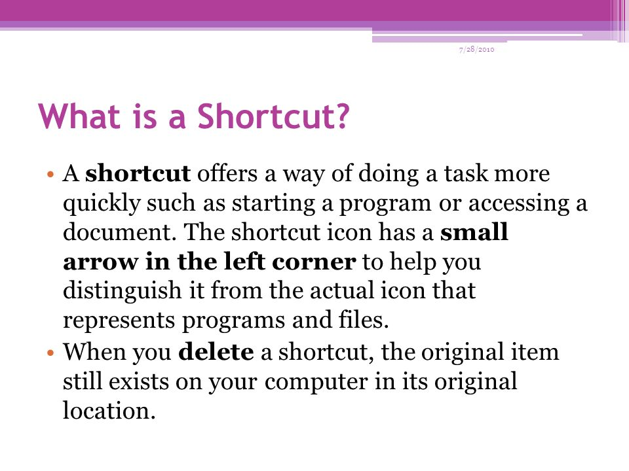
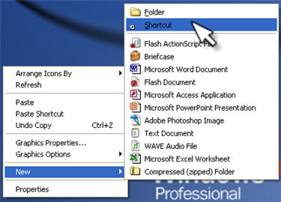
shortcut

Slide 41

GUI – graphical user interface
Modern operating systems provide graphical user interface (GUI) to make the applications software easier to use. A GUI allows a computer user to work directly with an application program by manipulating text and graphics on the monitor screen through the keyboard and a pointing device such as a mouse.

Slide 42


Drag
To drag files, folders or icons is to move them around on a desktop

Slide 43
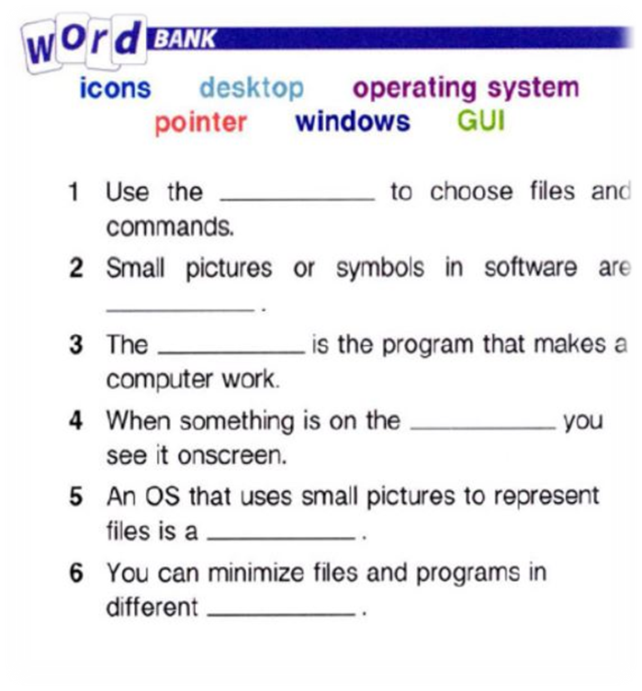
Fill in the blanks with the correct words or phrases from the word bank
pointer
icons
operating system
desktop
GUI
windows

Slide 44
Choose the best definition for each word
1. Drag
A. save an icon
B. close a desktop
C. move a file
2. Folders
A. organize files
B. move windows
C. create shortcuts
3. Shortcut
A. a type of software
B. a type of icon
C. a type of window

Slide 45
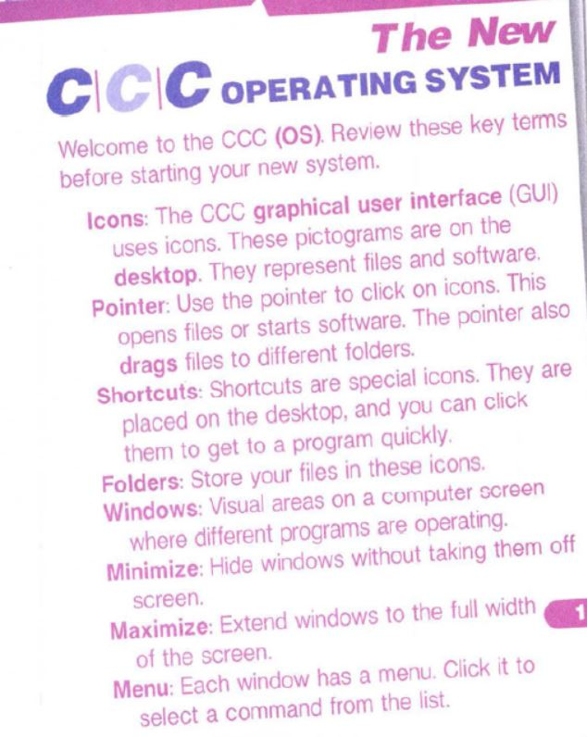
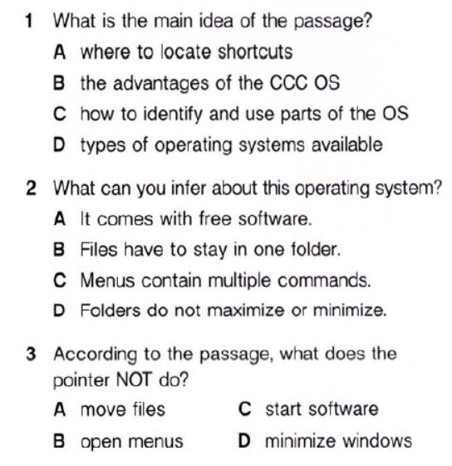
COMPUTER SCIENCE PROPOSAL infographics
Stage 01
Stage 02
Jupiter is big
Mercury is small
Stage 03
Stage 04
Saturn has rings
Venus is very hot
Earth
Stage 05
Stage 06
Neptune is far
Earth has life
Stage 07
Stage 08
Mars is red
The Sun is a star

Slide 46
Listen to a customer calling the help line about the operating system. Choose the correct answers.
1. What is the dialogue mainly about?
A. Saving files
B. Organizing icons
C. Finding shortcuts
D. Locating folders
2. The customer does not know where to find the ... .
A. icons
B. desktop
C. pointer
D. options menu

Slide 47
Listen again and complete the conversation
Support Technician: Hello, CCC Solutions. What do you need help with today?
Customer: Well, it's my 1) ________. I add a shortcut one day, and it's gone the next.
Support Technician: Oh, no problem. Just 2) ____them to the desktop.
Customer: Okay. How do I do that?
Support Technician: First, add the shortcuts. Then, move the pointer to the 3) _________ and click ‘save icons and folders’.
Customer: Options? 4) _______, where is that?
Support Technician: See the ‘CCC’ icon in the corner? 5) ________- that.
Customer: Got it. 6) ___________!
Answers: 1. desktop icons; 2. save; 3. options menu; 4. I’m sorry; 5. right-click; 6. Thanks

Slide 48
What is a wireframe? What types of wireframes are there?
Here should be a video to watch ;)

Slide 49
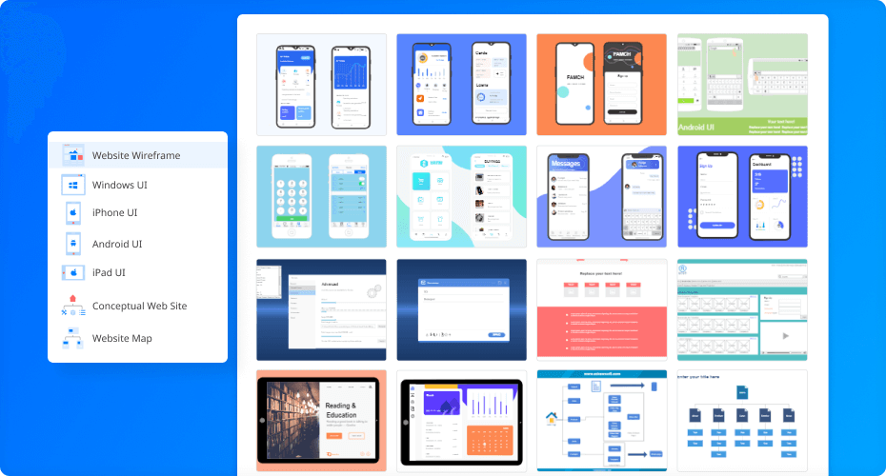
Case Study What are Wireframe tools and why are they important?

Slide 50
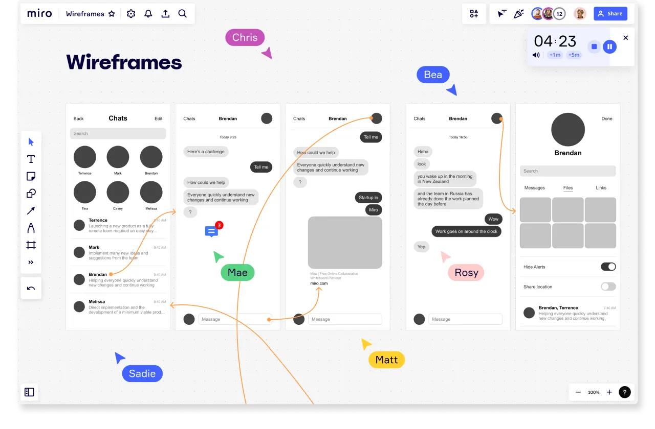
Wireframing is a simple way to visualize the design of an app or website, and to identify the elements of a new project. The simple diagram created will make it easy to visualize how the different elements will interact with each other and identify potential UI issues.

Slide 51
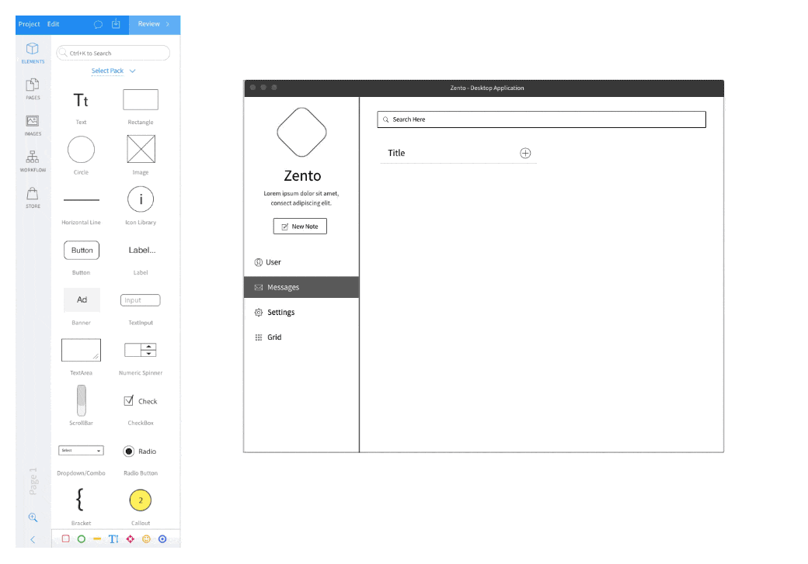

Slide 52

Figma
Skill Level:
Suitable for designers who are looking for a collaborative and simple design tool that requires no coding expertise.

Slide 53
Pros:
- The free plan comes with exciting features, cloud storage, and the benefit of collaborating with team members
- Frequently updated
- Unlimited viewers allowed on a project
Cons:
- Prone to lagging and doesn’t function properly in the absence of a strong internet connection
- Lacks control to restrict viewers’ actions when they access a shared prototype, so it’s best to make changes in the copy instead of the original design
Available on:
macOS, Windows, Web browsers, and Linux
Price:
- Free plan (up to 3 projects and 2 editors)
- Premium plan comes free for students and costs $12/month/editor with unlimited projects

Slide 54
Activity
Use one of the existing interfaces (websites, mobile apps, software applications) for a group critique. Provide constructive feedback based on usability principles and design guidelines. Experiment with different design ideas in a group.

Slide 55
Home assignment
Choose one of the websites to analyze the user interface and provide constructive feedback based on usability principles and design guidelines.

